Slide 1

2017-2018
Community Project Application Orientation
Notes:
Julie

Slide 2
Agenda
Welcome and Mission of The Junior League of Austin
Types of Support
Overview of Becoming a Community Project
ROUND TABLE Q&As
Community Projects
Placement
Done-In-A-Day
Spanish Immersion
Coats for Kids
Notes:
Julie

Slide 3
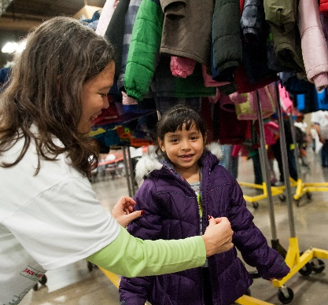
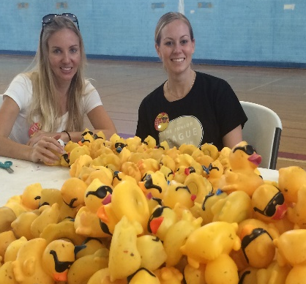
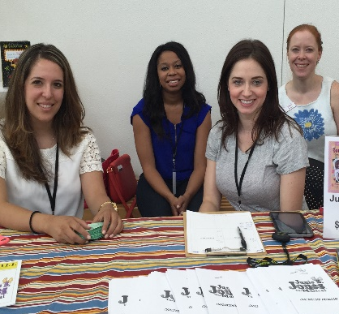
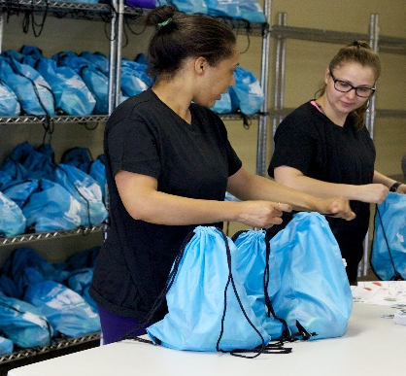
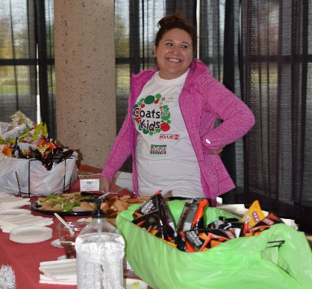
Mission Statement
The Junior League of Austin is an organization of women committed to promoting voluntarism, developing the potential of women, and improving the community through the effective action and leadership of trained volunteers. Its purpose is exclusively educational and charitable.
Vision Statement
Notes:
Julie

Slide 4
Facts about the Junior League of Austin
The Junior League of Austin (JLA) was founded in 1934
Today it is one of the five largest leagues based on:
  Size
  Dollars raised
  Funds contributed to the community
Membership is currently 2600+
  1360 Provisionals & Actives (current volunteer base)
  1250 Sustaining members
Over 80% of members work outside the home
Notes:
Julie
First league founded in 1901 in NYC

Slide 5
Facts about the Junior League of Austin
JLA contributes ~$800k a year to the community
Funds are raised through:
  A Christmas Affair
  Bunny Brunch & Austin Entertains
  Grants & individual donations
  The Square on Parkcrest Shopping Center
Volunteers donate 150,000+ hours a year
In 2016-2017 the JLA:
  Awarded 555 placements in 25 community projects
  Dedicated an additional 370 placements to JLA programs
Notes:
Julie, Introduce Silvia for Types of Support

Slide 6
Types of Support
Done-In-A-Day
Community Project
Notes:
Silvia – Mention no handouts this year, everything (including this PowerPoint) will be available on the JLA website.

Slide 7
DONE-IN-A-DAY
Done-In-A-Day (DIAD) is a committee of 40 Junior League members who fulfill a need for short term volunteer services for our community partners.
Volunteers work 4-hour shifts
You can submit multiple volunteer requests for up to 5 opportunities per cycle.
Our goal is to better meet your needs and the needs of our members.
Volunteers provide support at a variety of events including fundraisers, however volunteers may not solicit funds or goods for an agency prior to or during an event.
Notes:
Robin Burch

Slide 8
DONE-IN-A-DAY
Examples of Placements
  Holiday Party and Gift Donation Programs
  Food Bank Distribution
  Children Shoe Collection and Delivery
  10K Race Water Distribution
Notes:
Robin Burch

Slide 9
DONE-IN-A-DAY – Placement Cycles
Four Placement Cycles
Fall Cycle: September 2, 2016 – December 31, 2016
  Application Due: July 1, 2016
Winter Cycle: January 1, 2017 – March 12, 2017
  Application Due: September 2, 2016
Spring Cycle: March 13, 2017 – May 31, 2017
  Application Due: December 30, 2016
Summer Cycle: June 1, 2017 – August 31, 2017
  Application Due: March 17, 2017
Submit application using the form on our website. www.jlaustin.org
For Questions, please contact Robin Burch at diadchair@jlaustin.org
Notes:
Robin Burch

Slide 10
Coat for kids Community Fair
The Coats For Kids (CFK) Warm Bodies and Healthy Hearts Community Fair will be on December 10, 2016, from 8:30 a.m. to 1:00 p.m. outside of Palmer Events Center.
The Community Fair provides an opportunity for coat recipients who attend CFK Distribution Day to obtain first-hand information about applicable services and programs from other nonprofit agencies within the Central Texas community.
To participate, please contact Rachel Pry, Community Fair Lead at CFKFair@jlaustin.org.
Applications will be released at the beginning of September, and are due October 10, 2016.
Together, with The Junior League of Austin and the Coats for Kids Partners, nonprofit organizations can help us assist the community beyond “warmth.”
Notes:
Rachel Pry

Slide 11
Community Projects
Year long partnership with an agency
Six or more JLA volunteers
Minimum of 25 (2-hour) shifts
JLA funds may be awarded
JLA Project Chair sits on agency's board of directors as a non-voting member
Notes:
Jenn

Slide 12
¡Sí! SPANISH IMMERSION PROGRAM
Opportunity for agencies to have 2-3 volunteers with basic Spanish skills
League members take Spanish classes in the Fall
Enter community placements in the Spring
Including ¡Sí! positions will not make your application more competitive
¡Sí! Volunteers are in addition to the other volunteers you are requesting
Notes:
Gibbs

Slide 13
¡Sí! SPANISH IMMERSION PROGRAM
¡Sí! Placements should ensure direct contact with Spanish speaking clients
Face-to-face interactions with clients are preferred over telephone
¡Sí! placements should be similar or identical to the other placements – Select “YES” on application when asked if a placement would benefit from a Spanish-speaking volunteer.
Consider whether the placement will require the use of repetitive phrases, open-ended conversation, or both.
Notes:
Gibbs

Slide 14
Round Tables
Q & A Sessions available to meet your individual needs. Visit one of the Round Tables:
      Done-in-a-Day
      Community Projects: Application and Financial Questions
      Placement: Matching volunteer placements to JLA member needs
      Coats For Kids
      ¡Sí! Spanish Immersion Program
Notes:
Jenn, introduce Silvia for overview of Community Project Application Process

Slide 15
Community Project Selection Process
Community Orientation – August 9, 2016
Application deadline – August 24, 2016, by 3:30 p.m.
Initial Review Team – September 2016
Researchers Committee review – late September 2016 – February 2017
Board of Director’s review – February 2017
Membership vote – March 2017
Minimum of 6 volunteers must sign up – April 2017
Contracts issued – May 2017
Notes:
Silvia

Slide 16
Application Criteria
Must submit online application, and hard copies of supporting financial documents. Online application and supporting documents can be found on the “Apply to be a project” page of the Community Impact section of The Junior League of Austin website at www.jlaustin.org.
Must request volunteers/funds starting June 1, 2017,
through May 31, 2018.
Must be received in JLA office no later than 3:30 p.m. on
Wednesday, August 24, 2016. No exceptions.
Notes:
Silvia

Slide 17
Proposal Criteria
Volunteers only OR volunteers and funding
Minimum of 6 volunteers
Funding ranges between $0 and $25,000
Adequate training required for volunteers
Minimum of 25 shifts; Shifts are intended to be 2 hours in length
Notes:
Silvia

Slide 18
What is a placement
A “placement” is the JLA volunteer’s job at the agency
The Junior League of Austin follows the AISD holiday calendar
Role of Junior League Project Chair
    Coordinate/Communicate with Agency
    Lead the team of Junior League volunteers
    Connect the Junior League volunteers back to
    news/events within the JLA organization
    Attend agency's board of director meetings
Notes:
Silvia

Slide 19
Examples of Placements
Activity Coordinators
Audio Recorders
Camp Staff
Case Managers
Docents
Drivers
Editors
Event Planning
Gardeners
Mediators
Medical Support Team
Mentors
Social Media Programs
Tax Preparers
Veterinarian Assistants
Web Researchers
Notes:
Silvia

Slide 20
Placement Definitions
Please use the following definitions when requesting volunteer placements.
Fixed Schedule: Requires attendance at the same day/time each week for the duration of the placement.
Flexible Schedule: Requires regular attendance during the agency's operating hours, but offers flexibility in the scheduling. (For example, a volunteer could work Tuesday mornings one week and Wednesday evenings the following week.) Requires communication with the agency to inform when they will expect to have volunteers on hand.
Task Based/Remote: Completion of the assigned tasks as defined in the placement portfolio. Placement is not linked to the agency’s hours of operation or physical location and offers the greatest flexibility in scheduling.
Notes:
Silvia

Slide 21
Placement Time of Year
A volunteer may work either a Year-Long Placement OR a Concentrated Placement
  Year long = September – May (AISD calendar)
  Concentrated =
      Summer: June – August
      Fall: September – December
      Spring: January – May
All placements observe AISD holidays
Notes:
Silvia

Slide 22
Placement Highlights
Flexibility of schedule
High demand shift times and those that are less popular
Well-defined, clear expectations
Appropriate training and orientation provided
Safety of the placement – location, parking and task
Note “good to know” information such as:
    Prior computer or software training
    Pregnancy restrictions
    Knowledge of a second language
    Summer Camp – volunteer’s children permitted?
    Immunizations
    References or background check required
    Uniforms required
    Parking passes
Notes:
Silvia

Slide 23
Funding Request REMINDERS
Funding is granted only for a single year
Funding is a reimbursement process
Reimbursement requests and documentation are due 30 days after purchase
Funding requests must be related to volunteer placements described in application (no endowment funding)
Notes:
Silvia

Slide 24
Financial Documentation Required
Financial documentation is required with your application. In addition to the Financial Information Cover Letter (on the website), please provide us with 1 copy of each of the following items:
  Your IRS 501c(3) determination letter
  Latest Audit and Management Letter
  Most Recent Balance Sheet
  Budget to Actual for Previous and Current Fiscal Year End
  Most Current IRS Tax Return (Form 990). If your organization does not submit a Form 990, please provide an explanation letter signed by an executive officer.
Notes:
Silvia

Slide 25
PR Requirements For Projects
If selected as a project of The Junior League of Austin, we have the following PR requirements:
  The Junior League of Austin logo and listing on agency letterhead “as a project of The Junior League of Austin”
  The Junior League of Austin’s logo on agency website
  The Junior League of Austin’s logo and mention in agency newsletter
  The Junior League of Austin’s logo on all printed materials related to the project
Notes:
Silvia (?)

Slide 26
PR Benefits For Projects
If selected as a project of The Junior League of Austin, we will provide the following PR benefits:
  Agency link on JLA website
  Listing on JLA printed materials
  Listing of each project in JLA publications
  Member awareness about agency and issues
  Volunteer experience at agency
Notes:
Silvia (?)

Slide 27
General Proposal Information
If selected as a Junior League Community Project, you will be required to:
Provide $1 million liability insurance
Include The Junior League of Austin name/logo in all publicity about the project as previously outlined
Must invite JLA Project Chair to attend all agency board meetings of your agency as a non-voting advisor
Complete a year end report
Notes:
Silvia

Slide 28
Round Table Q&A
Notes:
Silvia

